Slide 1
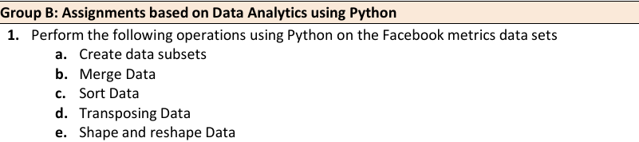
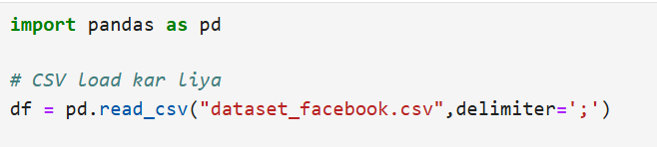
Step 1: Dataset Load karna

Slide 2
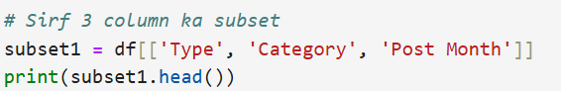
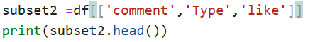
🔹 a. Create data subsets

Slide 3
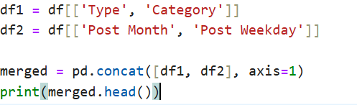
🔹 b. Merge Data

Slide 4
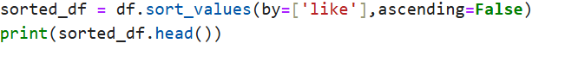
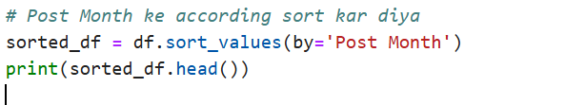
🔹 c. Sort Data

Slide 5
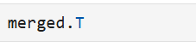
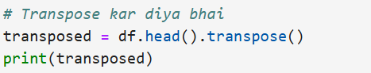
🔹 d. Transposing Data=>(Row ko column aur column ko row bana dena)

Slide 6
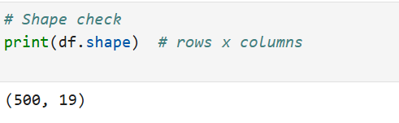
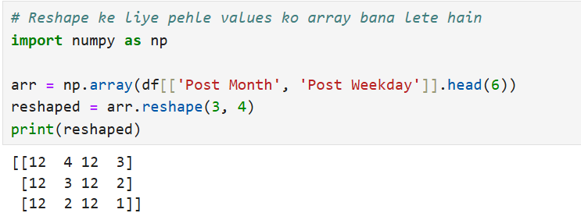
🔹 e. Shape and reshape Data=>(Data ka shape check karna ya usko naya shape dena (reshape karna)

Slide 7
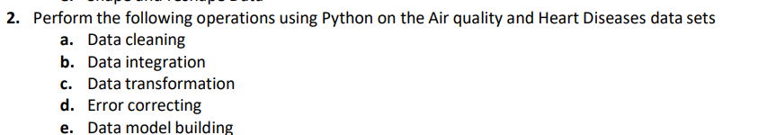
🧪 TE IT – DSBDA Practical (Group B-2)

Slide 8
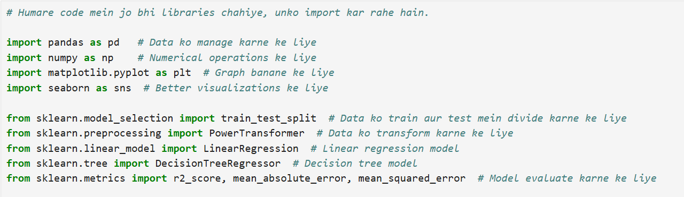

Slide 9
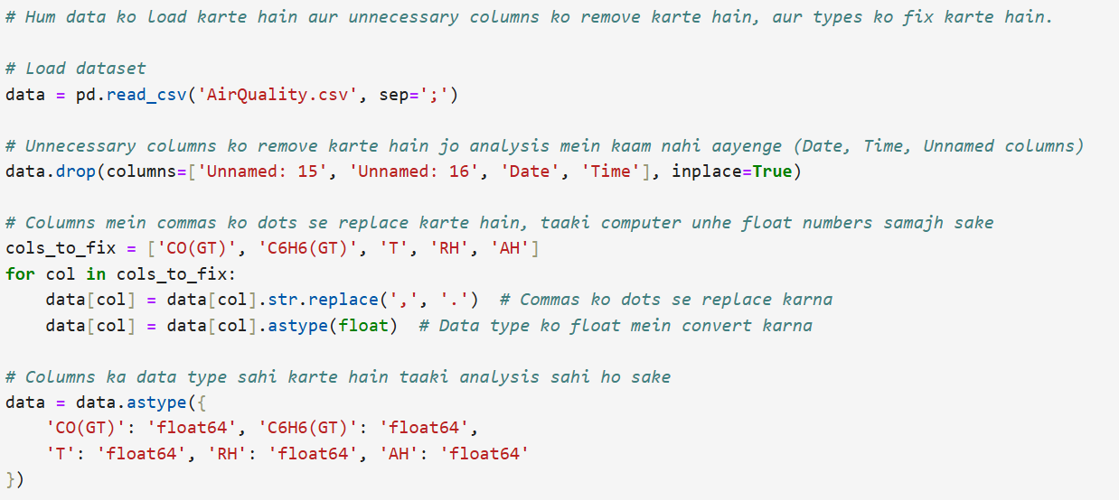
Step 1: Data Cleaning

Slide 10
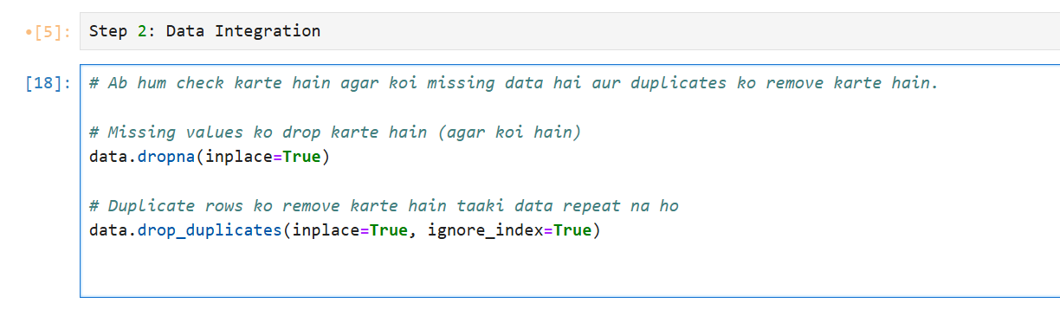
Step 2: Data Integration

Slide 11
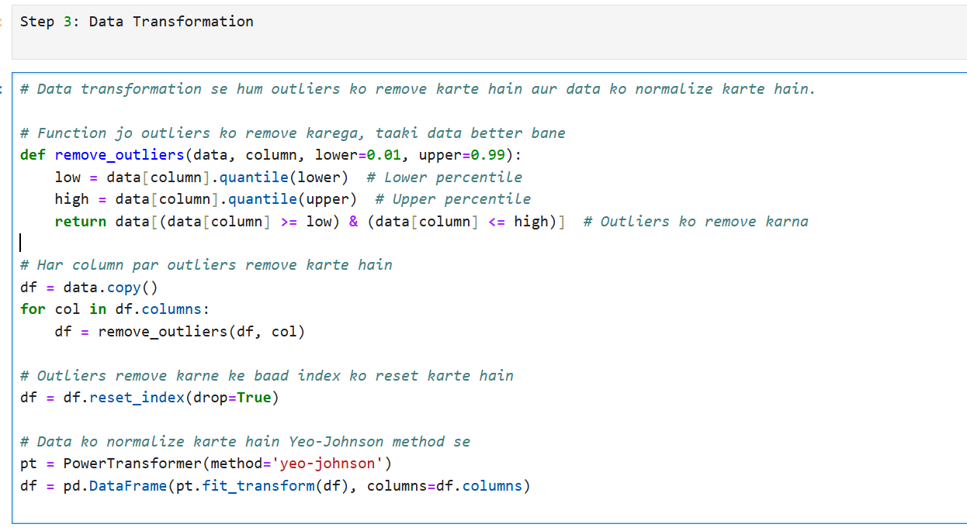

Slide 12
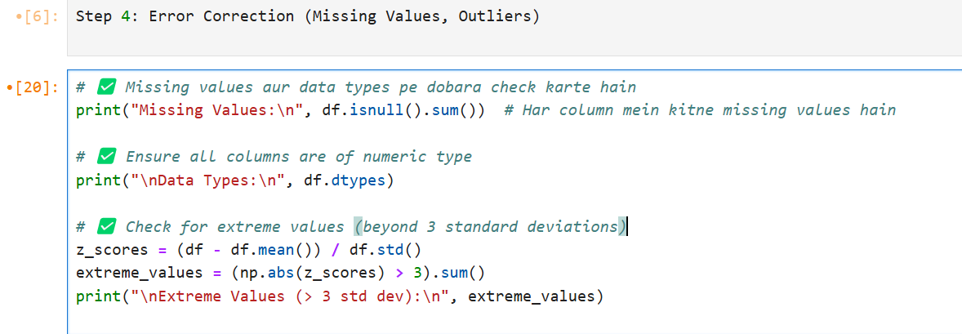

Slide 13
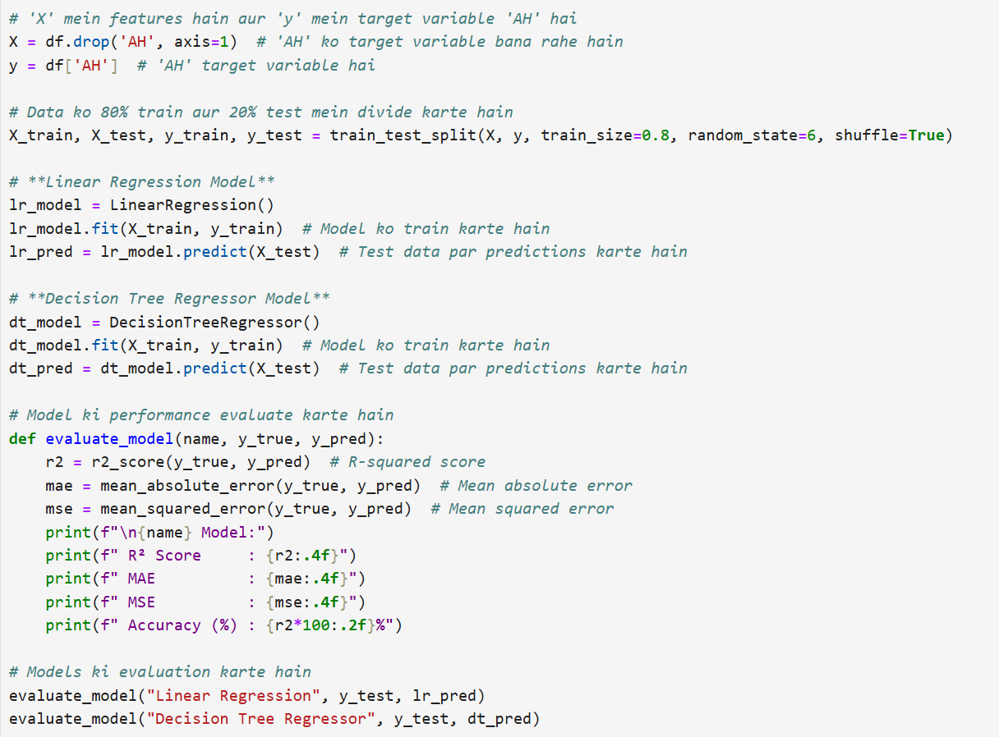
Step 5: Model Building

Slide 14
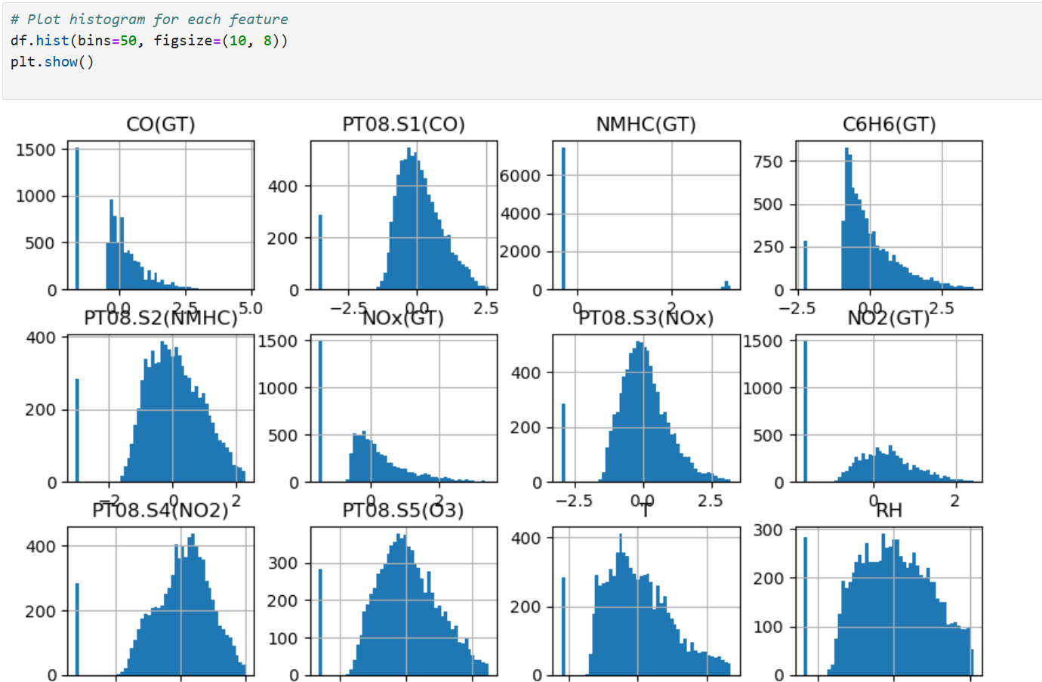

Slide 15
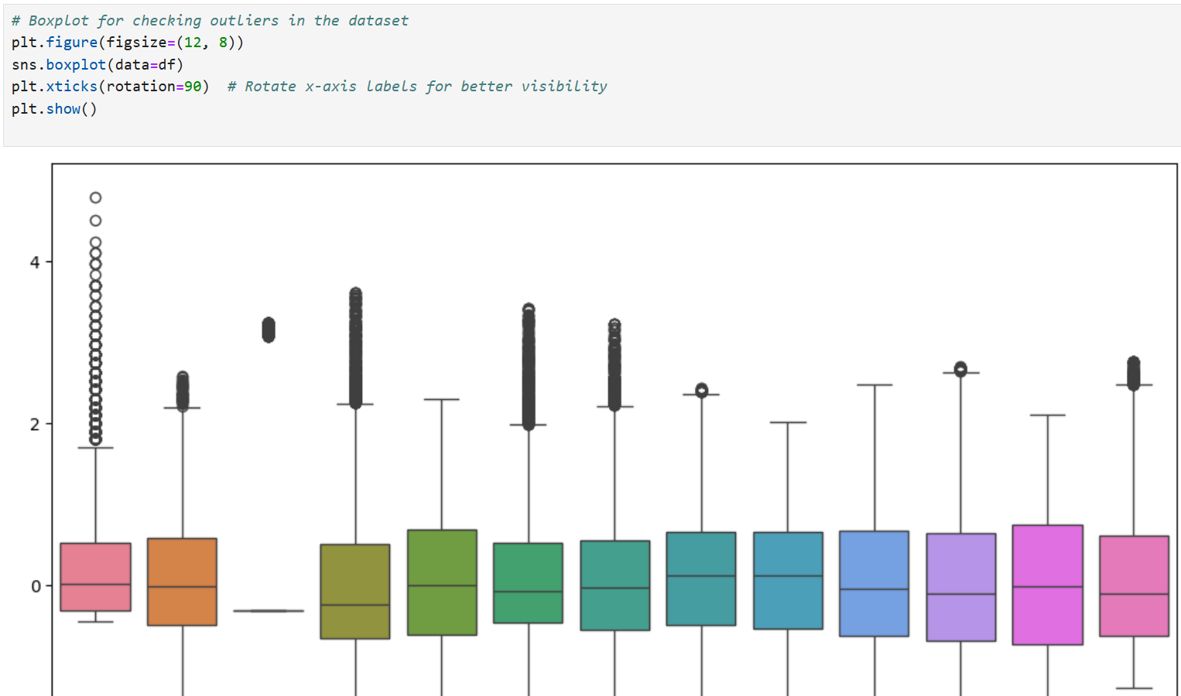

Slide 16
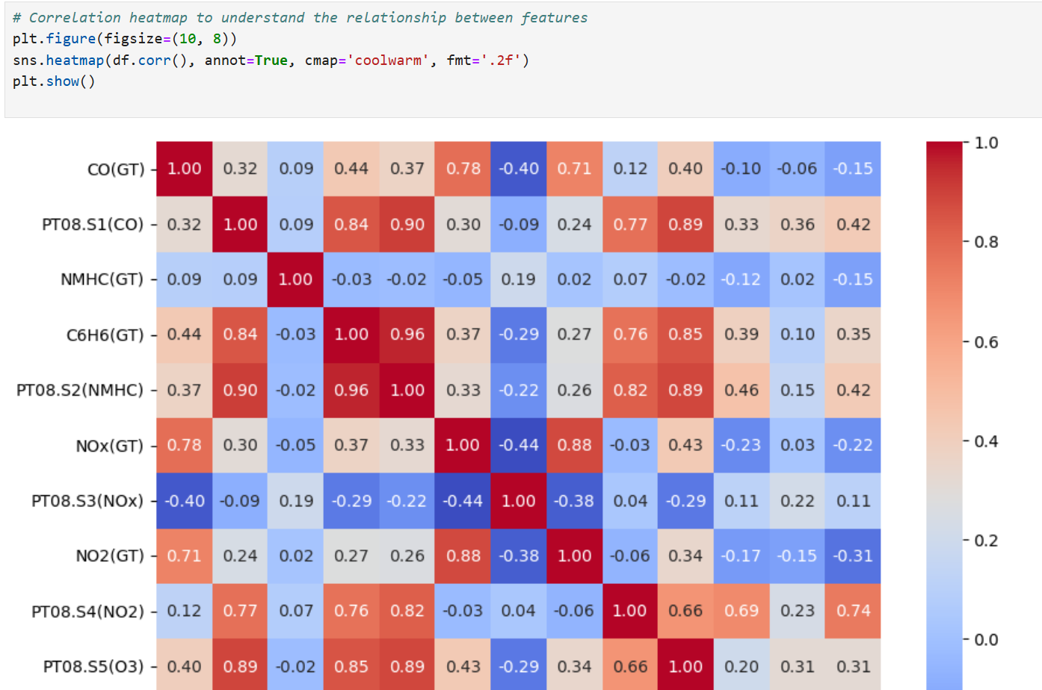

Slide 17
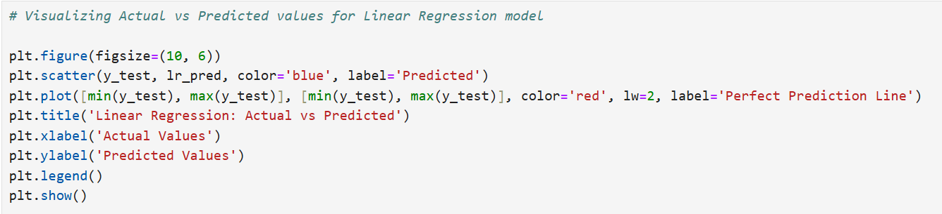
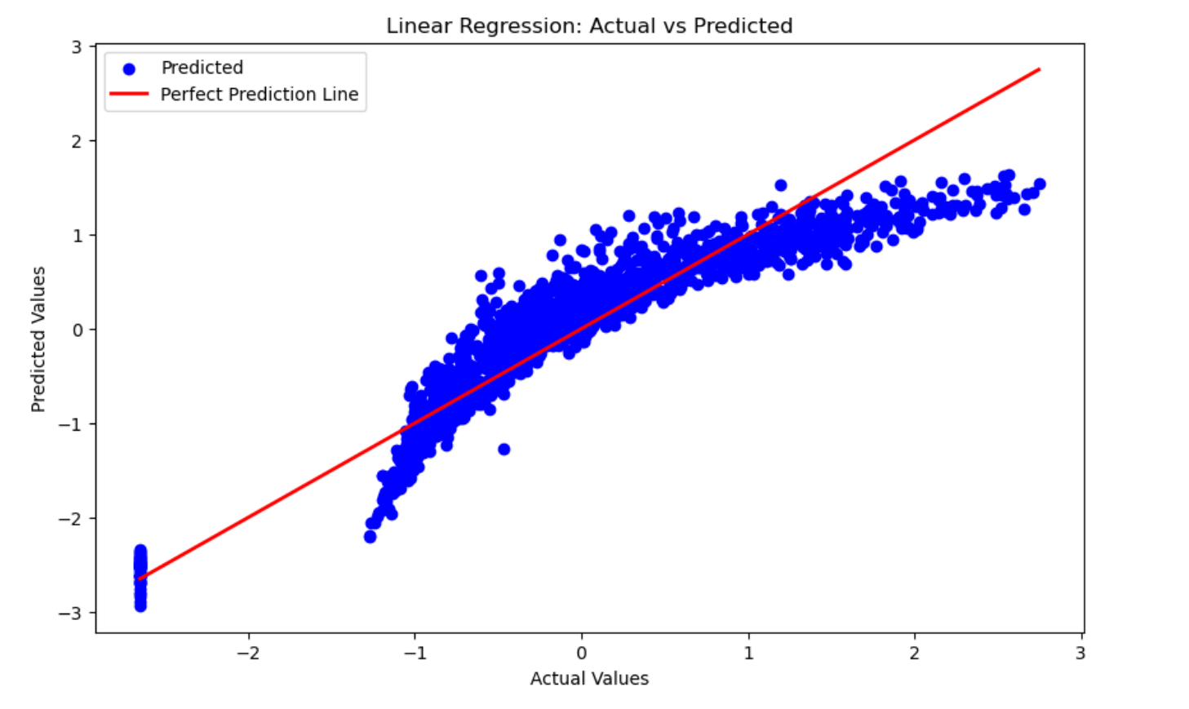

Slide 18
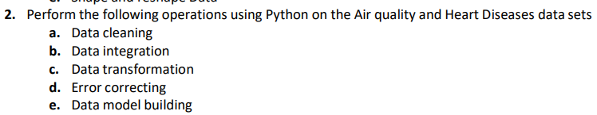
Heart Diseases DataSet

Slide 19
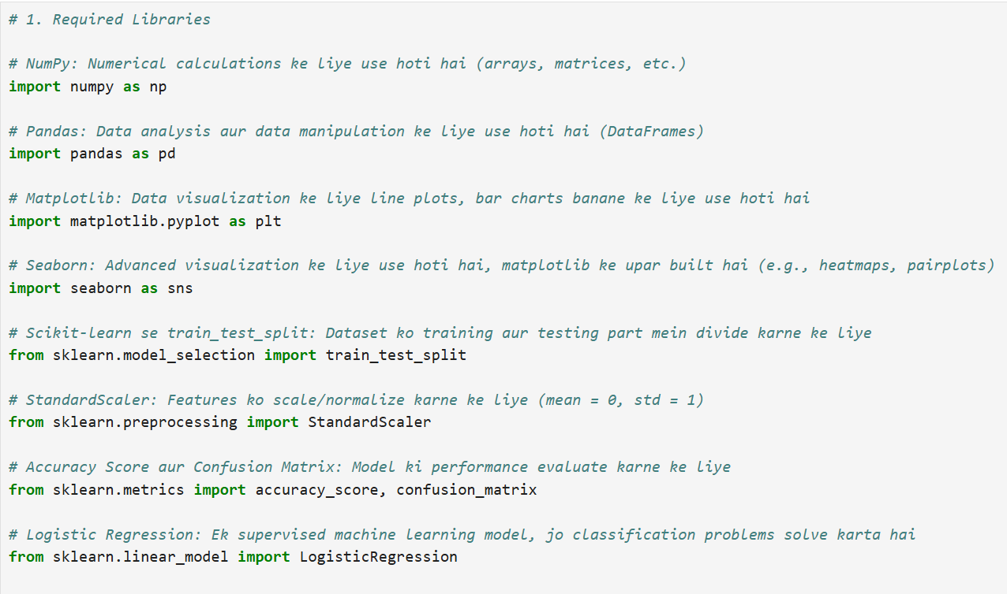

Slide 20
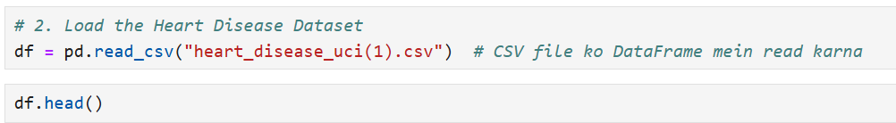

Slide 21
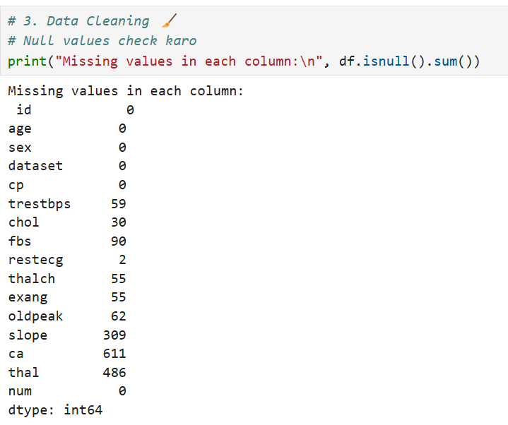

Slide 22
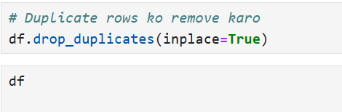

Slide 23
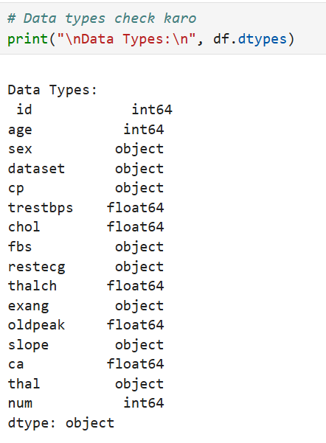

Slide 24
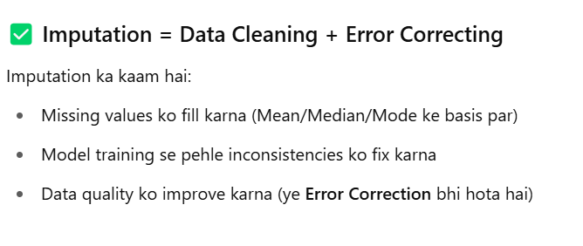

Slide 25
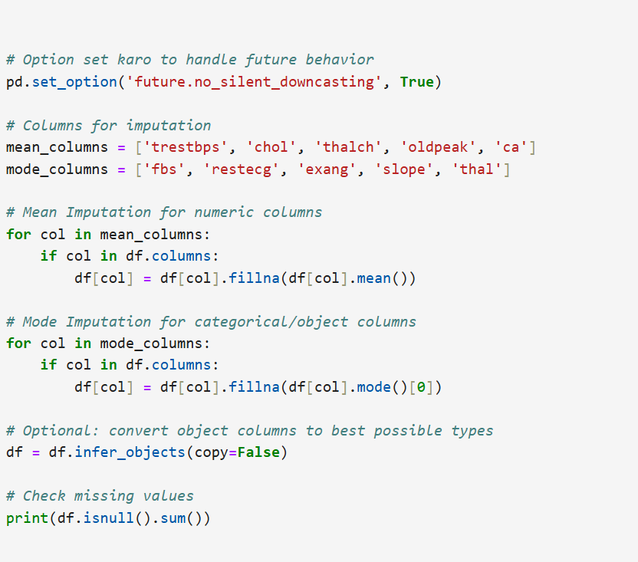

Slide 26
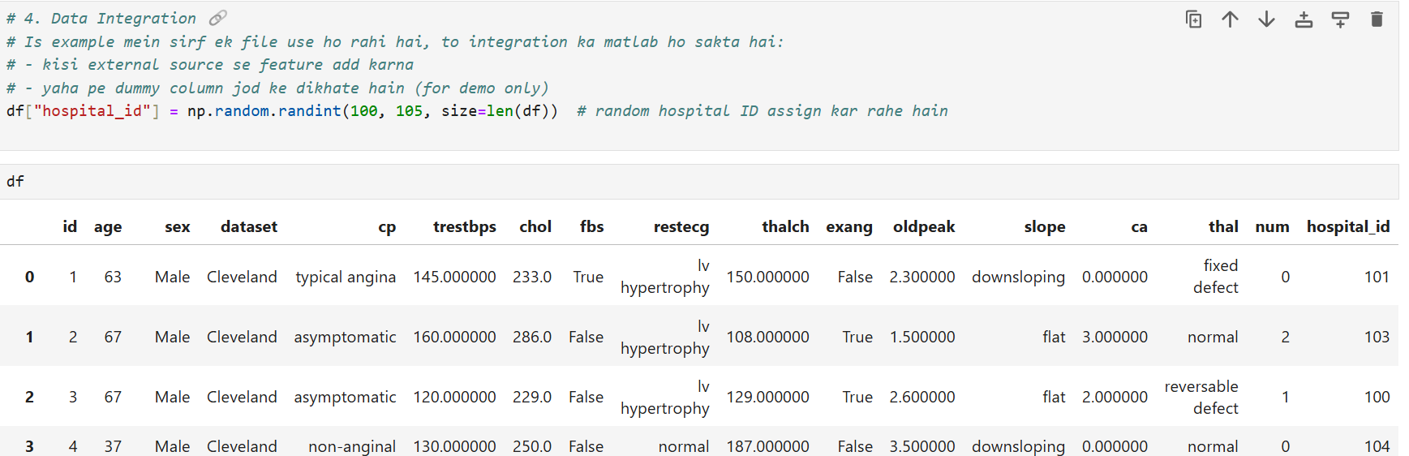

Slide 27
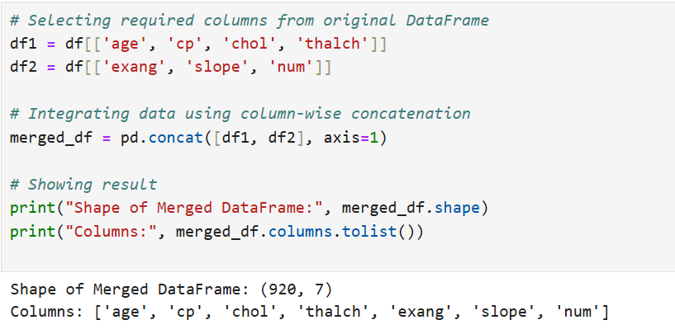

Slide 28
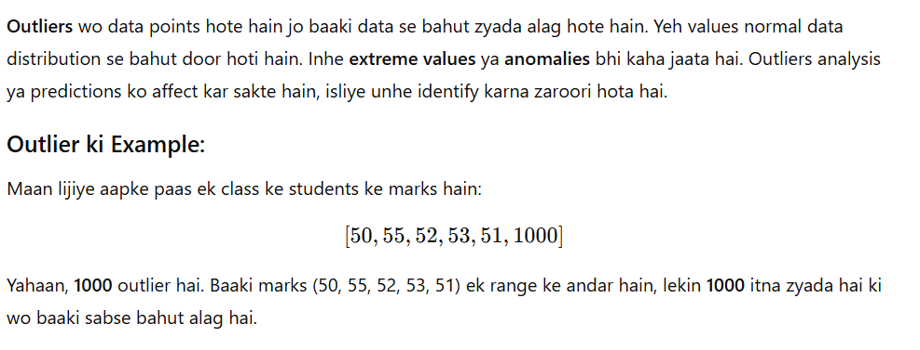

Slide 29
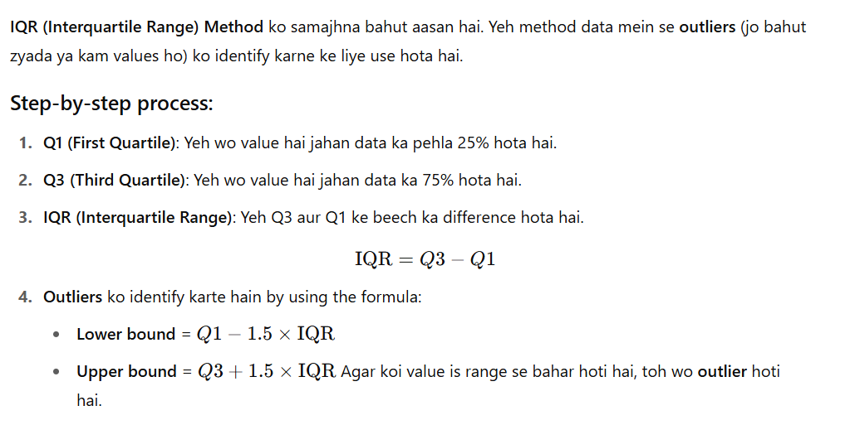

Slide 30
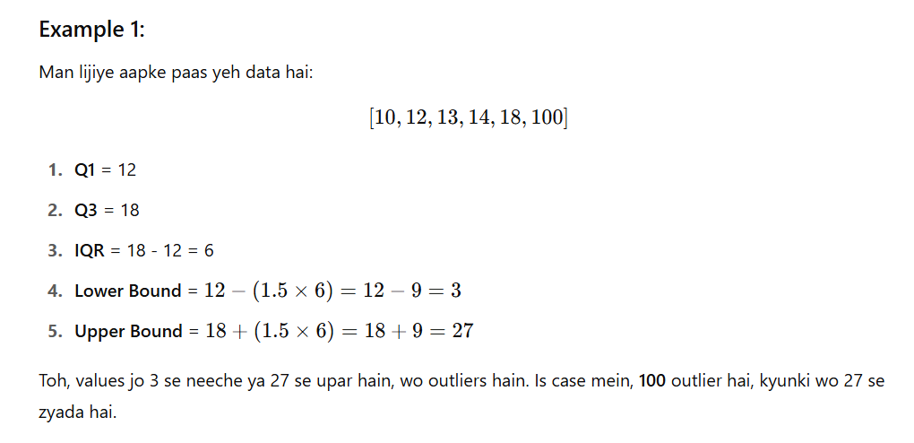

Slide 31
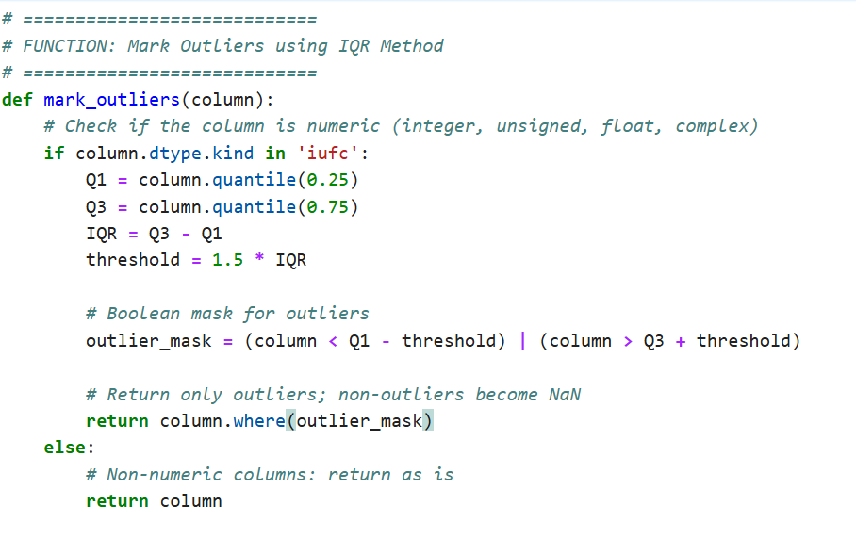

Slide 32
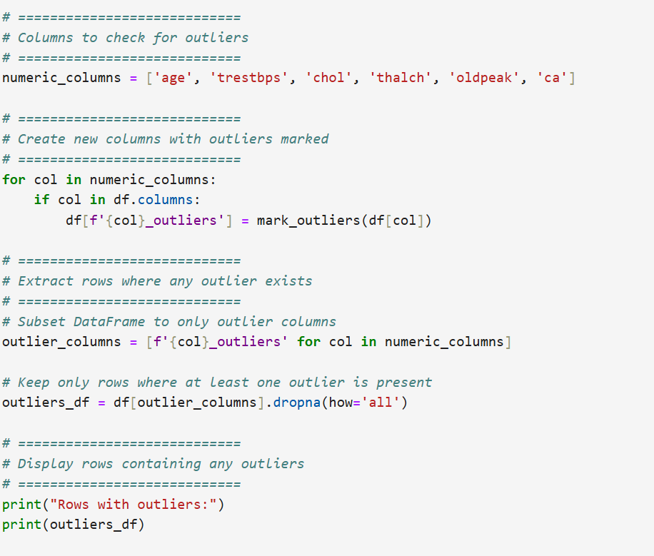

Slide 33
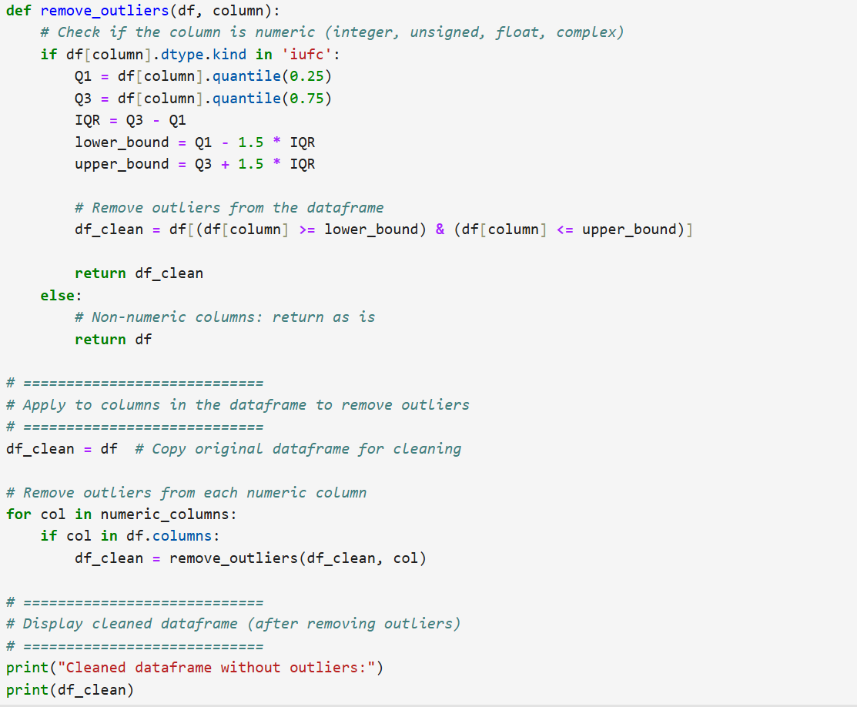

Slide 34
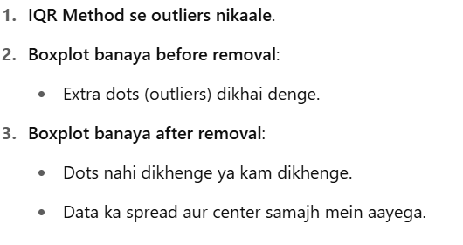

Slide 35
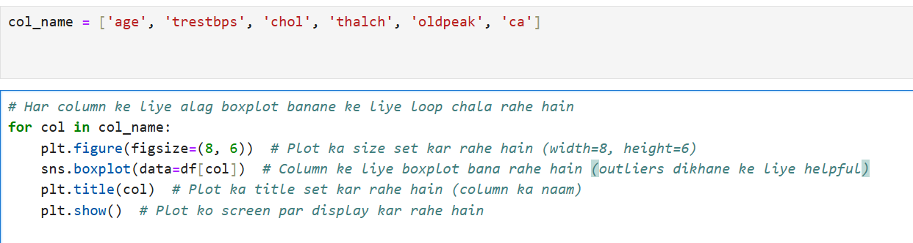

Slide 36
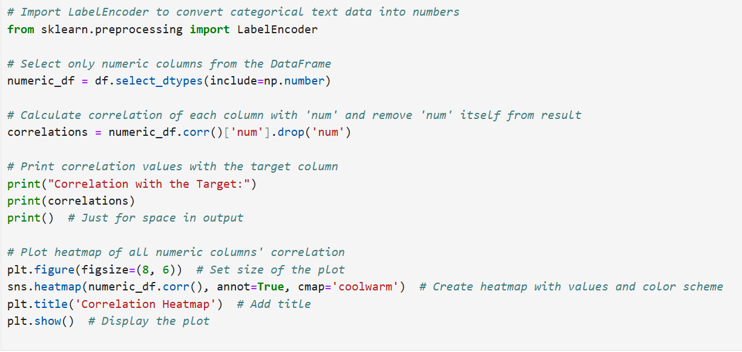

Slide 37
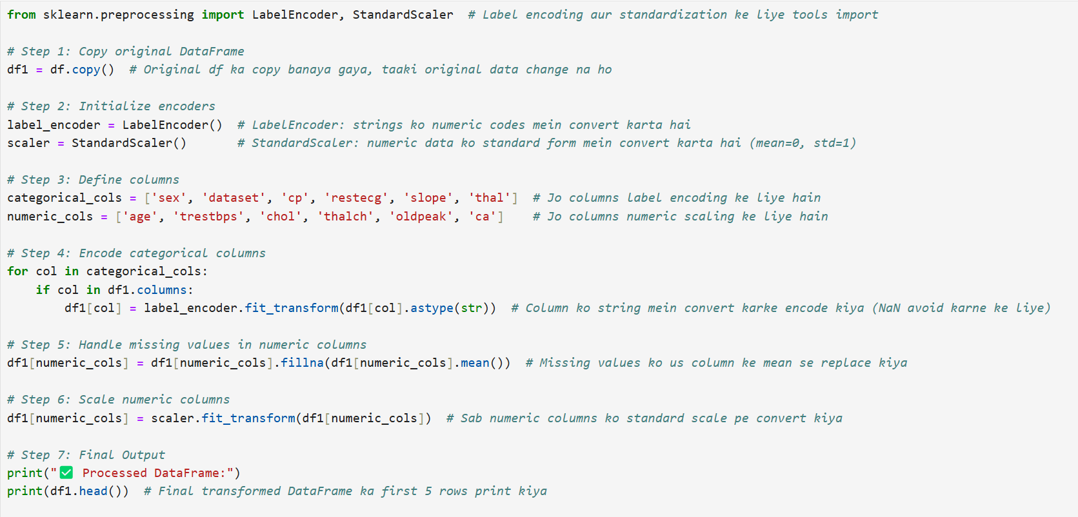
Data transformation

Slide 38
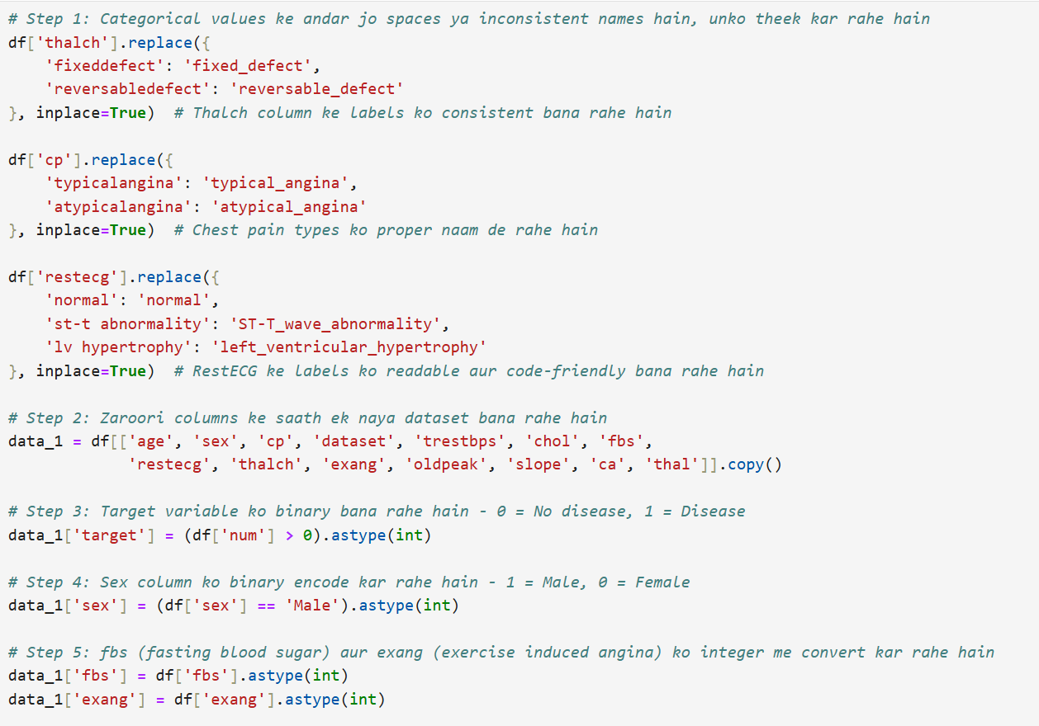
Model Building

Slide 39
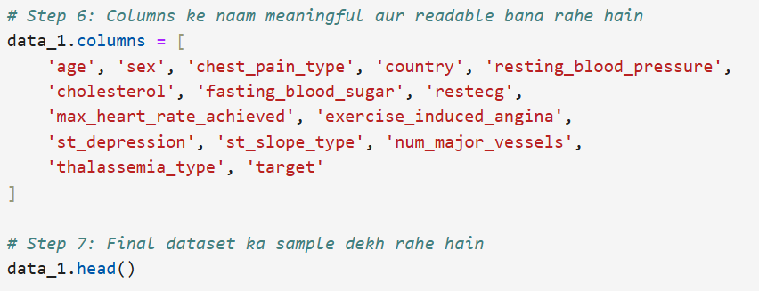

Slide 40
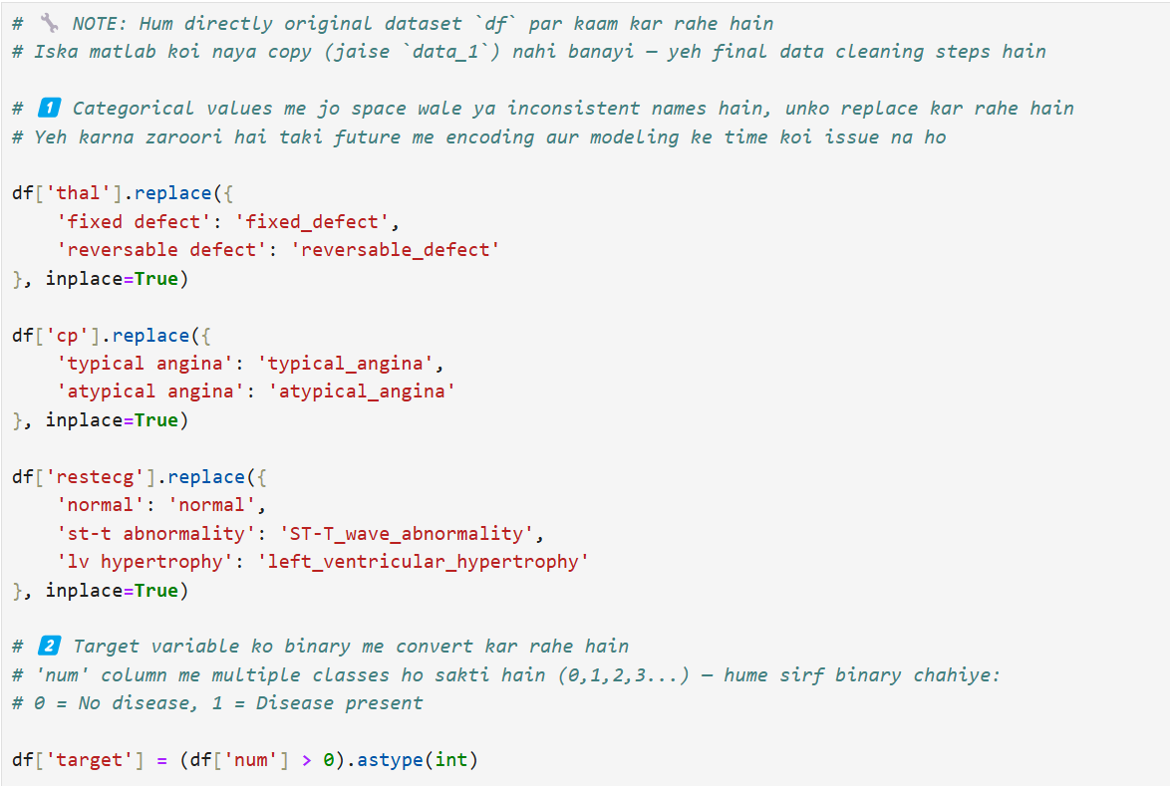

Slide 41
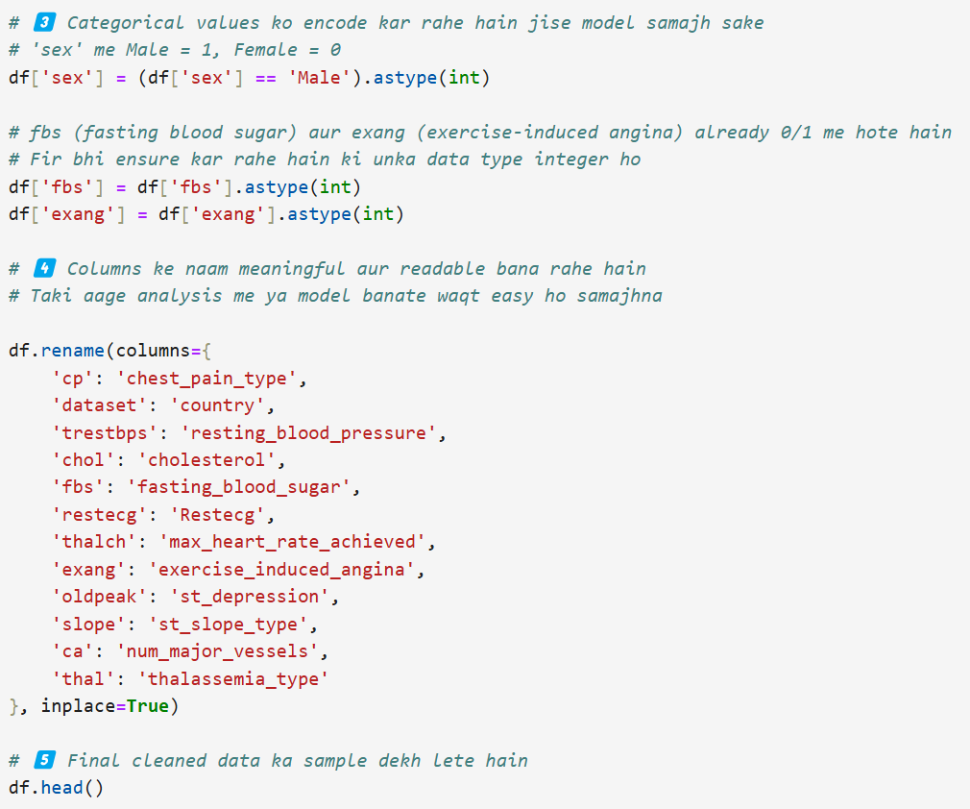

Slide 42
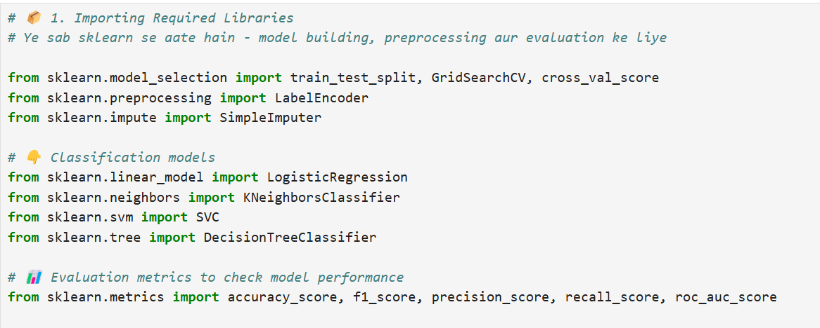

Slide 43
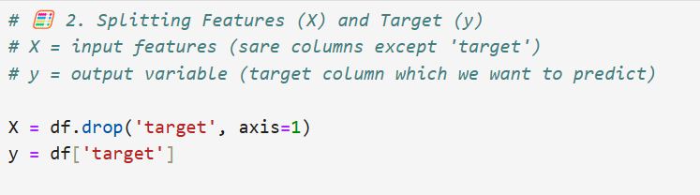

Slide 44
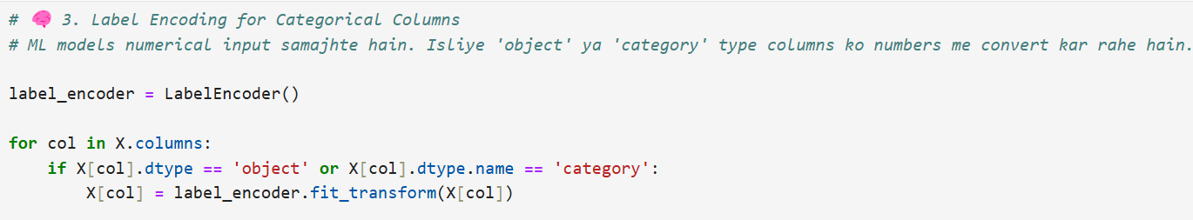

Slide 45


Slide 46


Slide 47


Slide 48


Slide 49


Slide 50


Slide 51


Slide 52


Slide 53
Assignment 4: Python Data Visualization using Matplotlib & Seaborn

Slide 54


Slide 55


Slide 56
🔹 Positive correlation ka matlab: dono values saath-saath badhti hain. 🔹 Negative correlation ka matlab: ek value badhti hai to doosri ghatti hai.
🔢 Feature Pair | 🔁 Correlation | 🧠 Explanation with Example Values (Hin+Eng)
thalch vs binary_target | -0.39 | Jab thalach (max heart rate) zyada hota hai, to heart disease hone ka chance kam hota hai. 🧪 Example: thalach = 170 → target = 0, thalach = 110 → target = 1
ca vs binary_target | 0.46 | Zyada number of major vessels (ca) blocked hone ka matlab heart disease ka high chance. 🧪 Example: ca = 0 → target = 0, ca = 3 → target = 1
chol vs binary_target | -0.23 | Cholesterol badhne par thoda heart disease ka chance badhta hai, but weak relation hai. 🧪 Example: chol = 200 → target = 0, chol = 290 → target = 1
oldpeak vs binary_target | 0.39 | ST depression (exercise ke baad) agar zyada hai, to heart disease ka risk bhi zyada. 🧪 Example: oldpeak = 0.0 → target = 0, oldpeak = 3.0 → target = 1
age vs thalch | -0.37 | Jaise jaise age badhta hai, maximum heart rate (thalch) naturally kam hota hai. 🧪 Example: age = 30 → thalach = 180, age = 60 → thalach = 120

Slide 57


Slide 58


Slide 59


Slide 60


Slide 61


Slide 62


Slide 63


Slide 64


Slide 65


Slide 66


Slide 67


Slide 68


Slide 69
📘 Air Quality Data Analysis & Visualizations

Slide 70
Library | Use
pandas (pd) | Data read karne, clean karne aur table jaisa structure manage karne ke liye
seaborn (sns) | Stylish aur statistical visualizations ke liye (matplotlib ka wrapper)
matplotlib.pyplot (plt) | Graph banane ke liye, basic plotting library

Slide 71
Part | Explanation
pd.read_csv("AirQuality.csv") | File ka naam "AirQuality.csv" hai, jise load kar rahe hain
sep=';' | Is CSV file mein data comma , se nahi balki semicolon ; se alag-alag hai
skipinitialspace=True | Columns ke values ke aage jo spaces hote hain unhe ignore karega

Slide 72
Column Name | Reason to Remove
Unnamed: 15 | Blank hai
Unnamed: 16 | Blank hai

Slide 73
# NaN values ko handle karne ke liye (optional step)
df = df.dropna()
dropna() ka matlab: jaha bhi missing (NaN) data hai, us row ko hata do
Ye step optional hai, but agar missing data zyada hai to analysis galat ho sakta hai
⚠️ Warning: Bahut zyada rows delete ho sakti hain agar zyada missing values hon.
Alternative: fillna() se missing values ko average ya 0 se bhar bhi sakte ho.

Slide 74
"whitegrid" style ka matlab: graph ke piche halka grey
grid aata hai, jo readability badhata hai

Slide 76


Slide 77


Slide 78
📘 Assignment 1: Single Node Hadoop Installation (Hadoop 2.9.0)
Goal: Hadoop ko ek system pe (Single Node/multinode) install karna aur run karna.

Slide 79

✅ 1. Java 8 Install karna (Hadoop ke liye required hai)

Slide 80

✅ 2. SSH Setup (Hadoop ko khud se connect karne ke liye zaroori hai)
(Hadoop ke liye password-less login chahiye hota hai)

Slide 81

✅ 3. Hadoop File ko Extract & Move karo

Slide 82

🔰 STEP 4: Environment Variables set karo .bashrc file mein

Slide 83
🔰 STEP 5: Hadoop Config Files setup karo

Slide 84


Slide 85


Slide 86


Slide 87


Slide 88


Slide 89


Slide 90


Slide 91


Slide 92
Process Name | Explanation
NameNode | Master node of HDFS — file system ka control karta hai
DataNode | Data store karne wala node
SecondaryNameNode | Metadata ka backup rakhta hai
ResourceManager | YARN ka master — job scheduling karta hai
NodeManager | Job execution ke liye responsible
Jps | Bas yeh command khud ko show karta hai

Slide 93



Slide 94

Sr. | Visualization Type | Kya Banana Hai?
a. | 1D (Linear) Data Visualization | Single variable ka simple chart
b. | 2D (Planar) Data Visualization | X vs Y axis graph
c. | 3D (Volumetric) Data Visualization | Teen variables ka graph
d. | Temporal Data Visualization | Time ke basis pe graph
e. | Multidimensional Data Visualization | 3+ variables ka visualization
f. | Tree/Hierarchical Data Visualization | Category ke andar sub-category
g. | Network Data Visualization | Node-Edge relation wala graph

Slide 95
🎯 ADULT DATASET ke liye - Tableau Visualizations
(a) 1D (Linear) Data Visualization

Slide 96


Slide 97


Slide 98


Slide 99


Slide 100



Slide 101



Slide 102


Slide 103


Slide 104


Slide 105


Slide 106


Slide 107


Slide 108


Slide 109


Slide 110
Customer name
Review (comment)
Rating
Comment tag (agar hai)
Stylish Casual Block Heels for Women.
https://www.meesho.com/stylish-casual-block-heels-for-women/p/5y67ap

Slide 111
🛒💬 Simple Real-Time Review Scraper (Python + BeautifulSoup)
Step 1: Required libraries install karo (1 baar hi karna hai)
!pip install requests beautifulsoup4

Slide 112


Slide 113


Slide 114


Slide 115


Slide 116


